Slide 1

DATA ANALYSIS ESSENTIALS PROJECT PRESENTATION
STREAMING DATA ANALYSIS AND VISUALIZATION
Presented by
N. Harsha Vardhan - 25B11CS243
P. Chandrakanth - 25B11CS715
M.N. Anvesh - 25B11CS057
C.K. Kamal Basha - 25B11CS148

Slide 2


INTRODUCTION
Streaming data is continuously generated data that can be analyzed to identify patterns, trends, and unusual activities. This project focuses on analyzing household energy consumption data by simulating a continuous data stream and extracting meaningful insights from it.
Dataset: Household Energy Consumption
Programming Language: Python
Libraries: Pandas, NumPy, Matplotlib
Analysis: Consumption Trends, Peak Usage & Anomalies
Visualization: Time-based and Statistical Graphs

Slide 3
OBJECTIVES
The main objective of this project is to analyze energy consumption data using Python. The project focuses on cleaning and organizing the data using Pandas, performing basic calculations and statistical analysis using NumPy, and understanding how energy consumption changes over time.
The project also aims to simulate streaming data by processing energy readings continuously, identify unusual energy consumption values, and find peak consumption periods. Finally, Matplotlib is used to create graphs and charts so that the analyzed data and patterns can be easily understood.

Slide 4
Features
Data Processing: Cleans and organizes the energy consumption data using Pandas.
Statistical Analysis: Calculates important values such as mean, median, minimum, maximum, and standard deviation using NumPy.
Streaming Simulation: Processes energy readings continuously to simulate a real-time data stream.
Average & Trend Analysis: Uses running and moving averages to understand energy consumption patterns.
Anomaly Detection: Identifies unusually high energy consumption values.
Time-Based Analysis: Finds the hours when energy consumption is higher or lower.
Data Visualization: Uses Matplotlib to display energy consumption patterns through graphs and charts.

Slide 5
DATASET
The dataset used in this project contains household energy consumption data recorded at regular time intervals. It includes information about appliance energy usage along with temperature, humidity, and date-time measurements. In this project, we mainly use the date and Appliances columns to study how energy consumption changes over time. The dataset helps us simulate streaming data, calculate energy consumption statistics, identify peak usage periods and unusual values, and visualize the results using Pandas, NumPy, and Matplotlib.

Slide 6
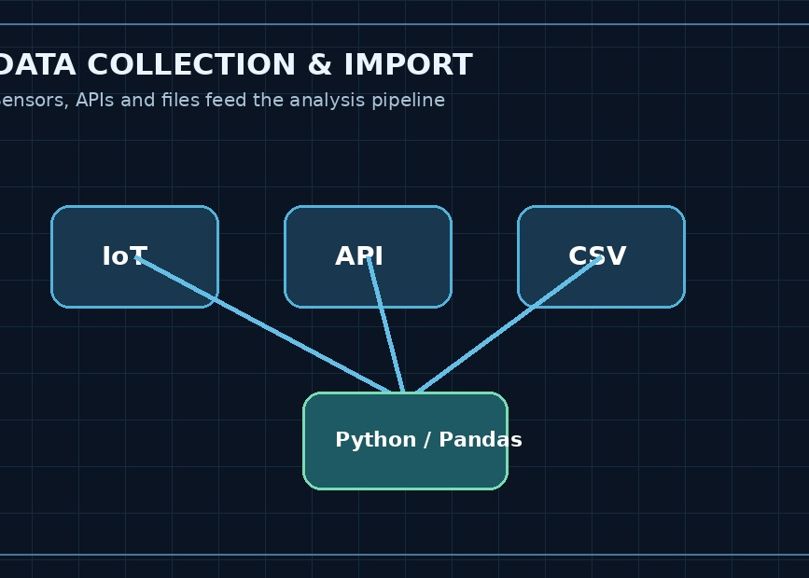
DATA COLLECTION & IMPORT
Sensor / IoT
Continuous measurements from connected devices.
Python / Pandas
API / Live Source
Import → validate → clean → transform
Timestamped events received from an external service.
CSV / Simulator
Useful for testing and replaying a streaming dataset.
Streaming data monitoring concept

Slide 7
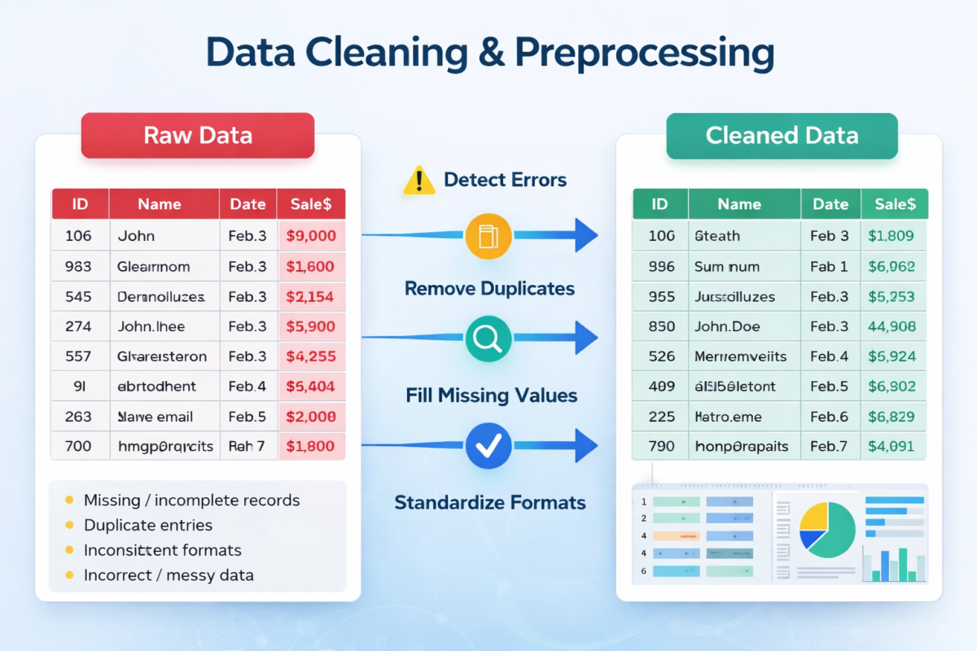
DATA PREPROCESSING
1. Missing Values
4. Transformation
Find empty readings and fill/remove them using a documented rule.
Parse timestamps, derive hour/day and sort chronologically.
2. Duplicate Records
5. Validation
Detect repeated events using event ID or timestamp + sensor.
Check data types and plausible ranges before analysis.
3. Outliers
6. Clean Dataset
Check unusual values with domain rules, IQR or z-score.
Create the analysis-ready stream used by charts and KPIs.
Data cleaning & preprocessing workflow

Slide 8
DATA ANALYSIS METHOD
1. Understand
2. Select
3. Clean
Problem + objectives
Dataset + features
Missing + duplicates
4. Transform
5. Analyze
6. Visualize
Time + categories
KPIs + trends
Charts + insights

Slide 9
PROJECT PROGRESS
1. Data Collection & Preparation Collected the household energy dataset and prepared the date-time information for analysis.
2. Data Analysis Performed statistical analysis using Pandas and NumPy to understand energy consumption.
3. Streaming Simulation Simulated continuous data arrival and calculated the running average of energy consumption.
4. Trend & Anomaly Analysis Used moving averages to identify trends and statistical methods to detect potential anomalies.
5. Data Visualization Created graphs using Matplotlib to visualize energy consumption over time and identify peak usage periods.

Slide 10
Data Cleaning
Import & Load Data
# Convert Date and Time into one column
df["DateTime"] = pd.to_datetime(
df["Date"] + " " + df["Time"],
errors="coerce"
)
# Convert Appliances to numeric
df["Appliances"] = pd.to_numeric(
df["Appliances"],
errors="coerce"
)
# Remove missing and duplicate records
df = df.dropna(
subset=["DateTime", "Appliances"]
)
df = df.drop_duplicates()
# Sort data
df = df.sort_values("DateTime")
# Create Hour column
df["Hour"] = df["DateTime"].dt.hour
print("Cleaned Data:")
print(df.head())
import pandas as pd
import numpy as np
import matplotlib.pyplot as plt
# Load Data
df = pd.read_csv(
"/content/household_energy_consumption.csv"
)
print("First 5 records:")
print(df.head())
print("\nDataset Information:")
print(df.info())

Slide 11
Streaming & Moving Average
Statistical Analysis
# Streaming Simulation
stream_data = []
for value in df["Appliances"].head(100):
stream_data.append(value)
running_average = np.mean(stream_data)
print("Streaming Simulation")
print("--------------------")
print("Records processed:", len(stream_data))
print("Running Average:", running_average)
# Moving Average
df["Moving_Average"] = (
df["Appliances"].rolling(window=10).mean()
)
# Statistical Analysis
mean_value = df["Appliances"].mean()
median_value = df["Appliances"].median()
minimum = df["Appliances"].min()
maximum = df["Appliances"].max()
std_value = df["Appliances"].std()
print("STATISTICAL ANALYSIS")
print("--------------------")
print("Mean:", mean_value)
print("Median:", median_value)
print("Minimum:", minimum)
print("Maximum:", maximum)
print("Standard Deviation:", std_value)

Slide 12
Anomaly & Peak Detection
# Hourly Analysis
hourly_consumption = (
df.groupby("Hour")["Appliances"].mean())
print("HOURLY CONSUMPTION")
print(hourly_consumption)
plt.figure(figsize=(12, 5))
plt.plot(
df["DateTime"],
df["Appliances"],
label="Energy Consumption"
)
plt.xlabel("Time")
plt.ylabel("Energy Consumption")
plt.title("Energy Consumption Over Time")
plt.legend()
plt.xticks(rotation=45)
plt.tight_layout()
plt.show()
plt.figure(figsize=(10, 5))
plt.bar(
hourly_consumption.index,
hourly_consumption.values)
plt.xlabel("Hour")
plt.ylabel("Average Consumption")
# Anomaly Detection
mean = df["Appliances"].mean()
std = df["Appliances"].std()
upper_limit = mean + (2 * std)
lower_limit = mean - (2 * std)
df["Anomaly"] = (
(df["Appliances"] > upper_limit) |
(df["Appliances"] < lower_limit)
)
anomalies = df[df["Anomaly"]]
print("Number of anomalies:", len(anomalies))
# Peak Consumption
peak_value = df["Appliances"].max()
peak_record = df[
df["Appliances"] == peak_value
]
print("Peak Consumption:")
print(
peak_record[
["DateTime", "Appliances"]
]
)

Slide 13
# Anomaly Detection Graph
plt.figure(figsize=(12, 5))
plt.plot( df["DateTime"], df["Appliances"], label="Consumption" )
plt.scatter( anomalies["DateTime"], anomalies["Appliances"], label="Anomaly" )
plt.xlabel("Time")
plt.ylabel("Consumption")
plt.title( "Energy Consumption with Potential Anomalies" )
plt.legend() plt.xticks(rotation=45) plt.tight_layout() plt.show()
# Moving Average Graph
plt.figure(figsize=(12, 5))
plt.plot(
df["DateTime"], df["Appliances"], label="Actual" )
plt.plot(
df["DateTime"], df["Moving_Average"], label="Moving Average" )
plt.xlabel("Time")
plt.ylabel("Consumption")
plt.title("Energy Consumption Trend")
plt.legend()
plt.xticks(rotation=45)
plt.tight_layout() plt.show()

Slide 14
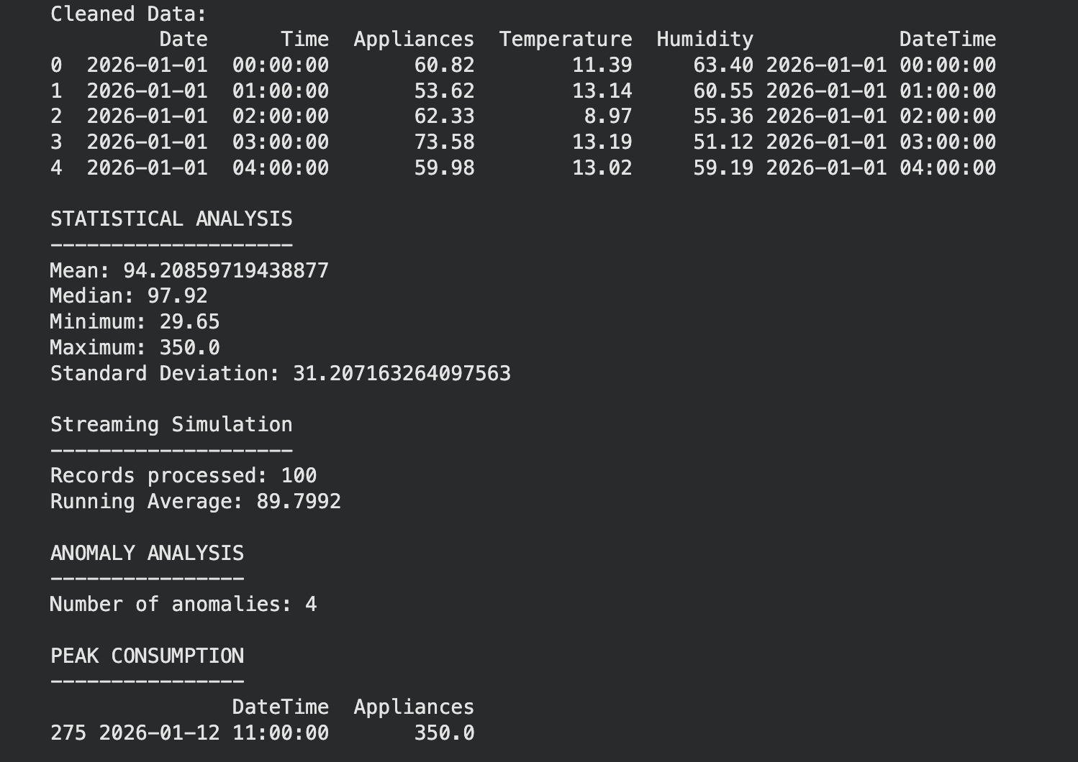
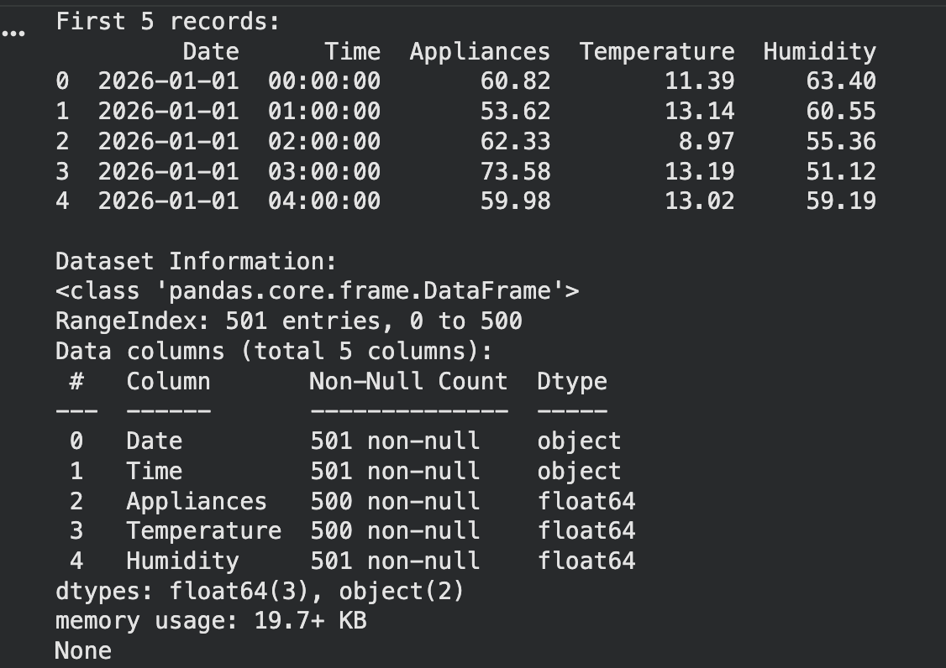

Slide 15
DATA VISUALIZATION
After cleaning and analysing the dataset, we use visualization to present the results clearly.
Charts and graphs make numerical data easier to understand and compare.
The bar chart is used to compare ratings between different restaurants.
The pie chart shows the distribution of Positive, Neutral, and Negative customer feedback.
The box plot compares the distribution of Overall Ratings across feedback categories.
The histogram shows the distribution and frequency of Food Ratings.
The line chart shows the variation in Food Rating and Service Rating across the records.
The scatter plot shows the relationship between Food Rating and Overall Rating.
These visualizations help us identify patterns, differences, trends, and relationships in the dataset.

Slide 16
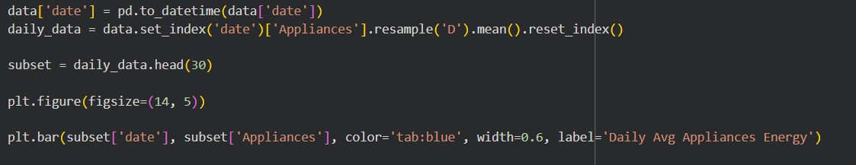
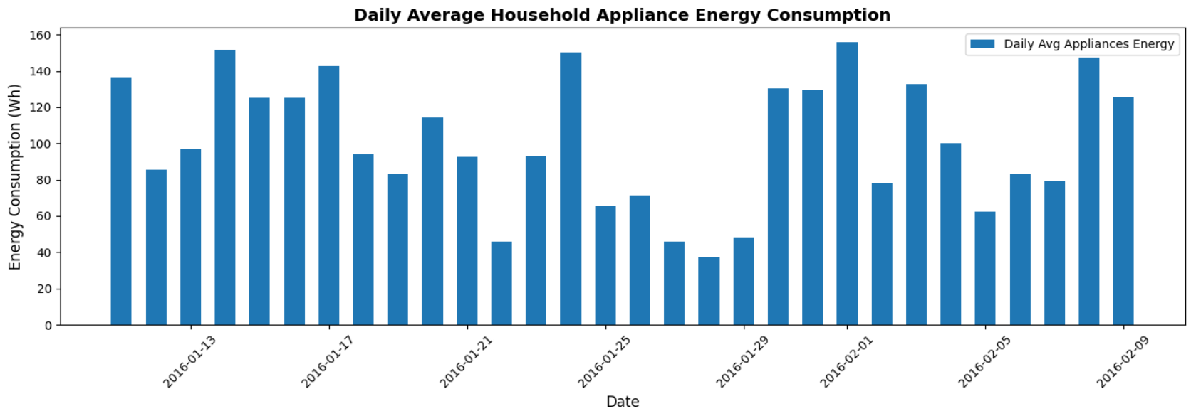
BAR CHART

Slide 17
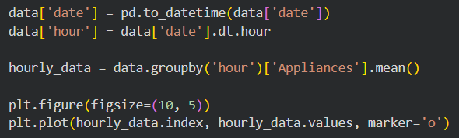
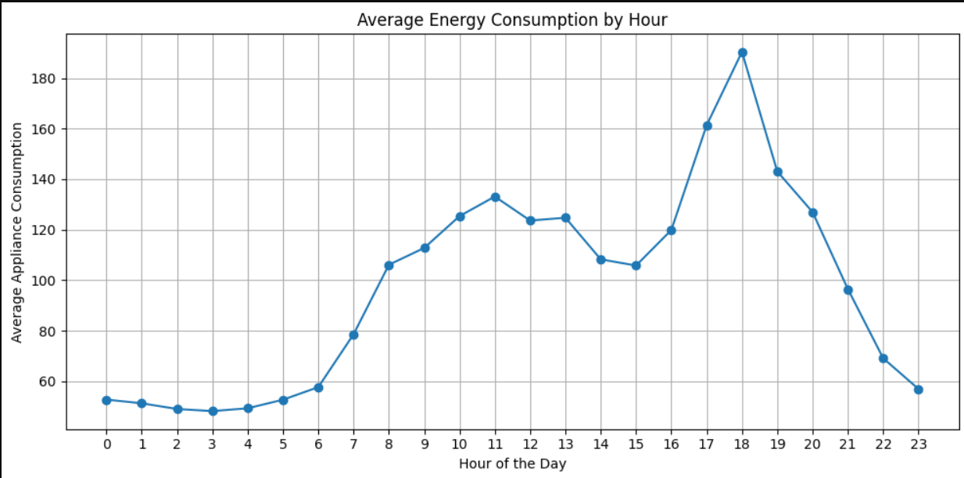
Line Chart

Slide 18
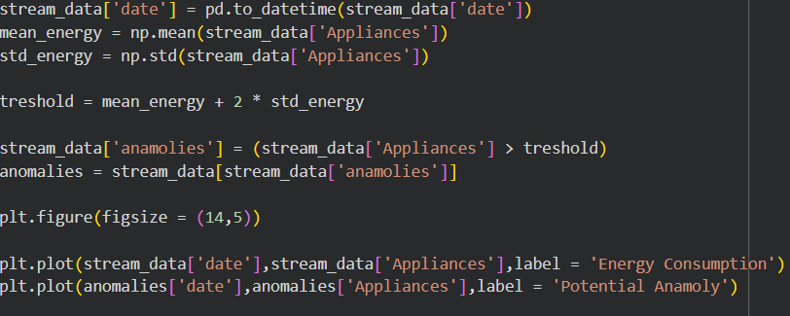
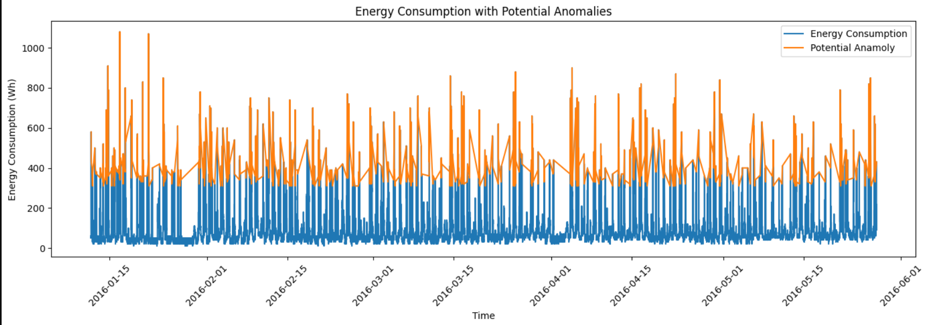
Line Chart

Slide 19
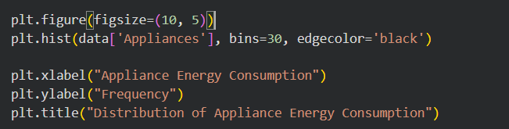
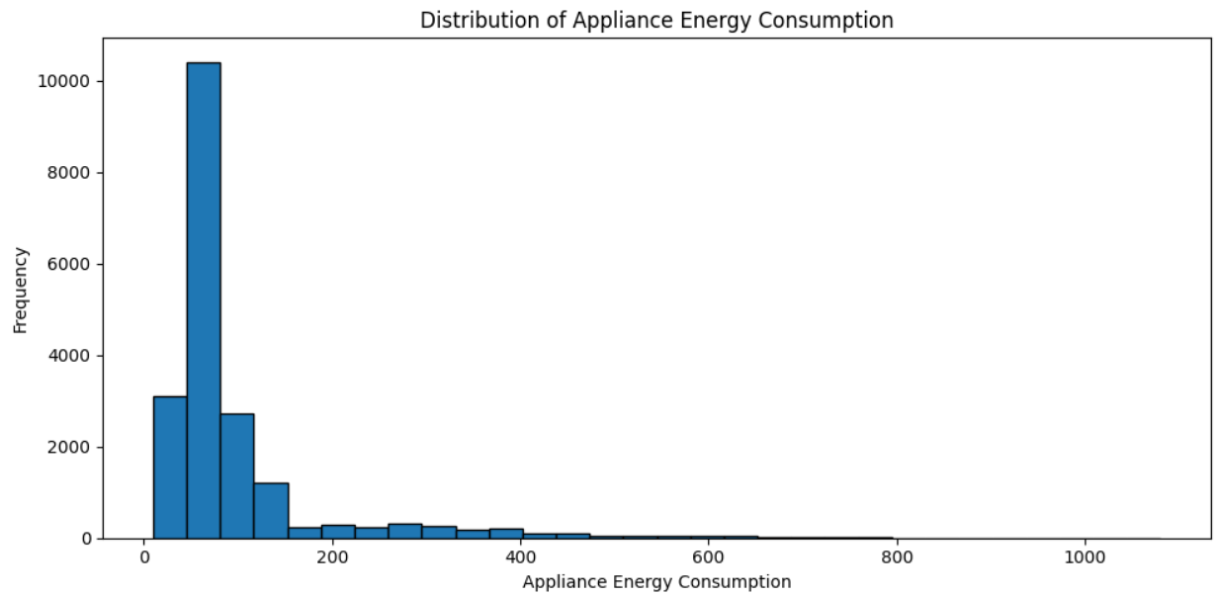
Histogram

Slide 20
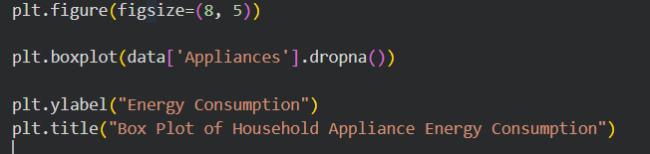
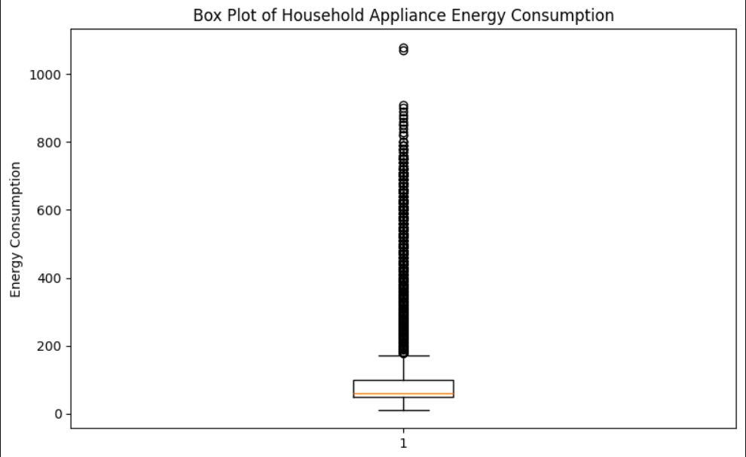
Box Plot
The box plot represents the distribution of household appliance energy consumption.
It shows the median, quartiles, and spread of the energy consumption readings.
The line inside the box represents the median energy consumption.
The box represents the middle 50% of the readings.
Points beyond the whiskers indicate potential outliers.
It helps identify variations in energy consumption and unusually high or low readings.

Slide 21
CONCLUSION
• The Streaming Data Analysis and Visualization project successfully analyzes household energy consumption data.
• Pandas and NumPy were used for data processing, statistical calculations, and analysis.
• Date and time data were processed to identify energy consumption patterns over different time periods.
• Matplotlib was used to create visualizations such as line charts, bar charts, histograms, box plots, and scatter plots.
• Energy consumption patterns were analyzed to understand daily and hourly usage variations.
• Potential anomalies were identified by detecting unusually high energy consumption readings.
• Overall, the project helps understand household energy usage patterns, identify unusual consumption, and gain useful insights for better energy management and decision-making.

Slide 22
Thank you

